Slide 1
Predict PIN using Simulated power traces

Slide 2
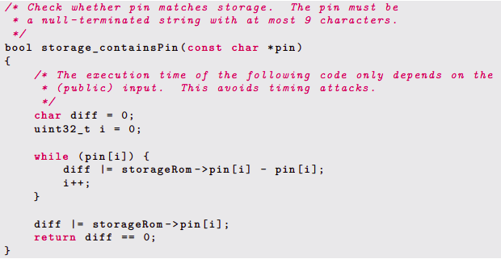
Vulnerability in Trezor-One Firmware
As noted by [1], in the actual pin comparison function of Trezor-one digit are processed one after the other and the comparison with pin is done in a deterministic way.
So basically, our task is to perform a side-channel attack on each digit of the pin.

Slide 3
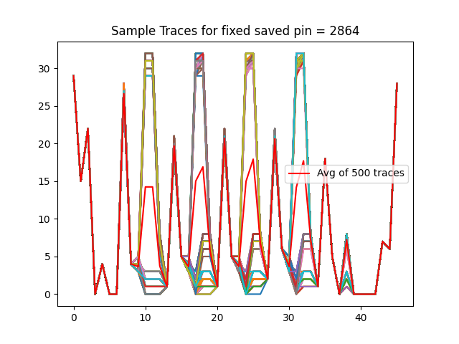
We have generated 1,50,000 traces for random input_pin and stored_pin for designing model for each digit.
After that, we generated 500 sample traces and take an average of that traces, which graph is presented at the side.
Here, stored_pin is 2864 and input_pin is generated random for each trial.

Slide 4
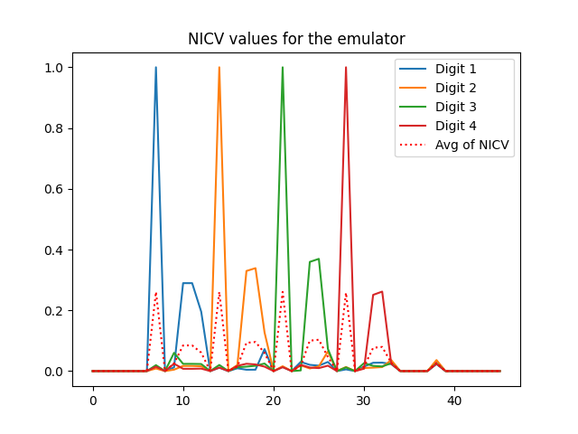
Now to check the dependency between our side channel traces (the power traces) and the processed data (the values of storageRom->pin/pin). We chose the Normalized Inter-Class Variance.
A NICV close to 0 means that our partitioning (i.e. sensitive value fi) failed to explain the variance. A NICV of 1 means that our partitioning perfectly explained the variance.
The four NICV (one per fi) are computed on the profiling set, and the results are displayed on figure.

Slide 5
ML Based Side Channel Attack on the device.
We have trained classifiers for each digit with SVM using a linear kernel
Trained with 1500 traces
We use the SVM models that we trained for each digit to retrieve the actual pin, for which we explored three strategies.
Random Pin input strategy
Chosen Pin input strategy
Iterative Pin input strategy

Slide 6
ML Based Side Channel Attack on the device.
We have trained classifiers for each digit with SVM using a linear kernel
Trained with 1500 traces
We use the SVM models that we trained for each digit to retrieve the actual pin, for which we explored three strategies.
Random Pin input strategy
Chosen Pin input strategy
Iterative Pin input strategy

Slide 7
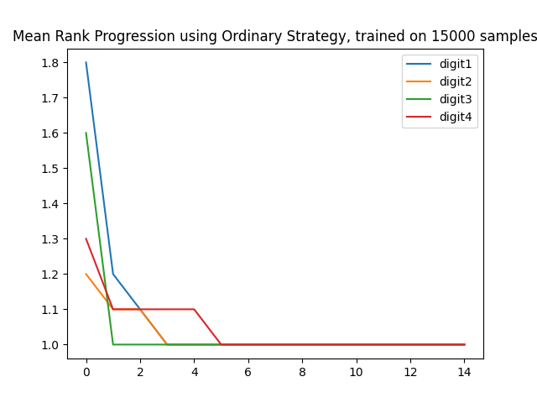
Random Pin input strategy
In each trial (15) for Stored_Pin:
Generate random input_pin
Get Traces for the actual and input pin
Give these traces to the trained model to find the probability of each digit.
Store the predicted probability of each digit
Repeat 1,2,3 for 15 rounds
Finally, Find the most probable digit at each place.
As can be seen, we can get the correct pin in 6 tries.

Slide 8
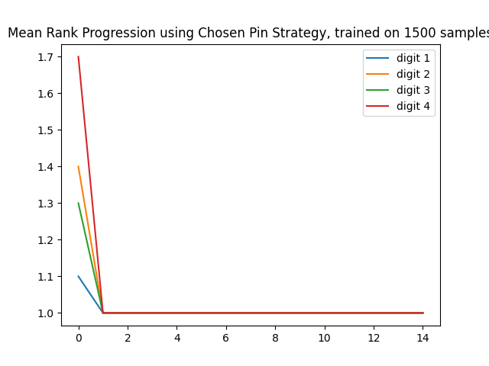
2) Chosen Pin Strategy
Use First input pin as “5555”
In each trial for Stored_Pin:
Get Traces for the actual and input pin
Store the predicted probability of each digit
Use the most probable digits as the next
input pin.
Repeat 1,2,3 till input == stored pin
As can be seen, we can get the actual pin within 2 tries using the chosen pin strategy

Slide 9
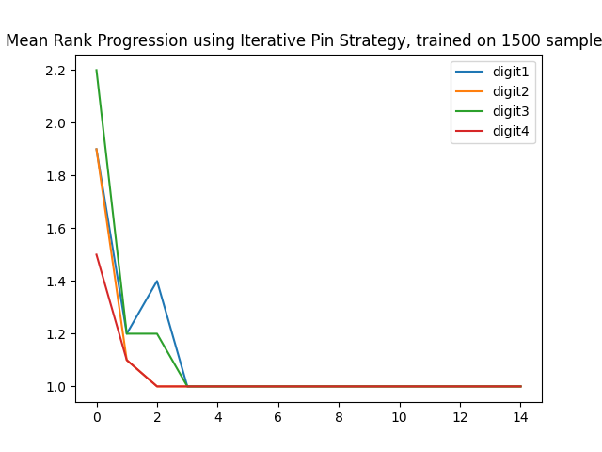
3) Iterative Pin Strategy
Use the First input pin as “1111”
In each trial for Stored Pin:
Get Traces for the actual and input pin
For each index, check if the input pin digit is the most probable predicted digit.
If Yes, keep the input pin digit the same
Else increment the digit by 1.
Repeat 1,2,3 till input == stored pin (for max 9 trials)
As can be seen, we can get the actual pin within 4 tries using the iterative pin strategy

